Slide 1

Malignant Comment Classifier Project
Submitted by: Nidhi Charde.
Nidhi Charde.
Vishvendra ingh

Slide 2
INTRODUCTION
The proliferation of social media enables people to express their opinions widely online. However, at the same time, this has resulted in the emergence of conflict and hate, making online environments uninviting for users. Although researchers have found that hate is a problem across multiple platforms, there is a lack of models for online hate detection.

Slide 3
CONCEPTUAL BACKGROUND OF THE DOMAIN PROBLEM
Online hate, described as abusive language, aggression, cyberbullying, hatefulness and many others has been identified as a major threat on online social media platforms. Social media platforms are the most prominent grounds for such toxic behaviour.
There has been a remarkable increase in the cases of cyberbullying and trolls on various social media platforms. Many celebrities and influences are facing backlashes from people and have to come across hateful and offensive comments. This can take a toll on anyone and affect them mentally leading to depression, mental illness, self-hatred and suicidal thoughts.

Slide 4
ANALYTICAL PROBLEM FRAMING
It is a binary classification problem with malignant comment labelled as 1 and not malignant labelled as 0.
We have 159571 comment records in the dataset.
There are in total 8 features in the dataset.
Since the dataset contains text data, we need to use Natural Language processing techniques for predicting malignant comments.

Slide 5

VISUALIZATION AND DATA INTERPRETATION

Slide 6
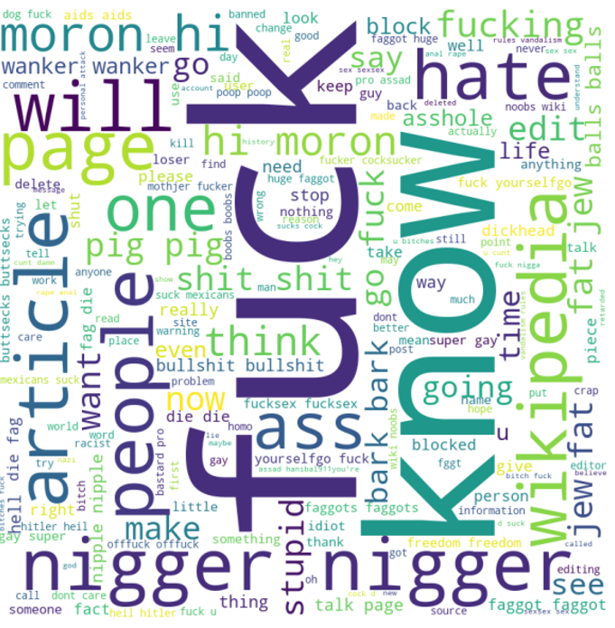
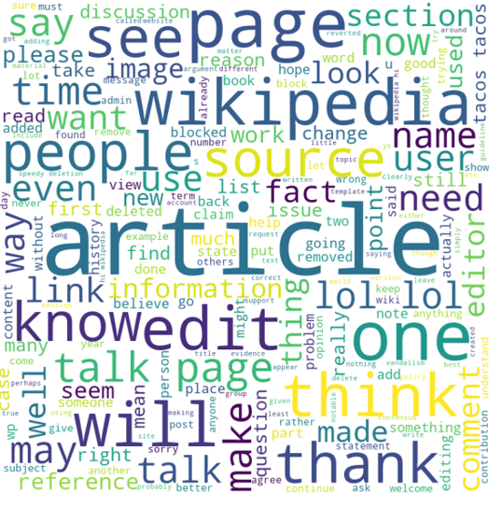
WORDCLOUDS - Malignant vs Non Malignant predicted by the Model
Malignant
Non Malignant

Slide 7
VARIOUS MODELS USED FOR VALIDATION
Logistic Regression
Random Forest Model
Ada-Boost Classifier
K Nearest Neighbour

Slide 8
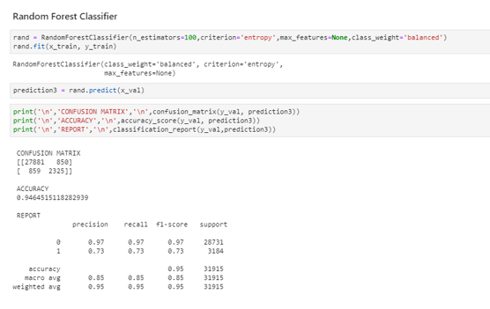
FINAL MODEL

Slide 9
KEY FINDINGS
Converted the problem into a binary classification problem. If the value in any of the columns: malignant, loathe, rude etc == 1 clubbed them together into one group and for rows with values == 0 counted them as non-malignent.
Plotted word cloud for all the different types: 'malignant', 'highly malignant', 'rude', 'threat', 'abuse', 'loathe'.
Logistic Regression was the best model with 94% accuracy and best f1 score.

Slide 10
THANK YOU

